Slide 1
Standards & Regulations Presentation
Team E: OuterSense

Slide 2
#1. ISO 26262
Road Vehicles – Functional Safety

Slide 3
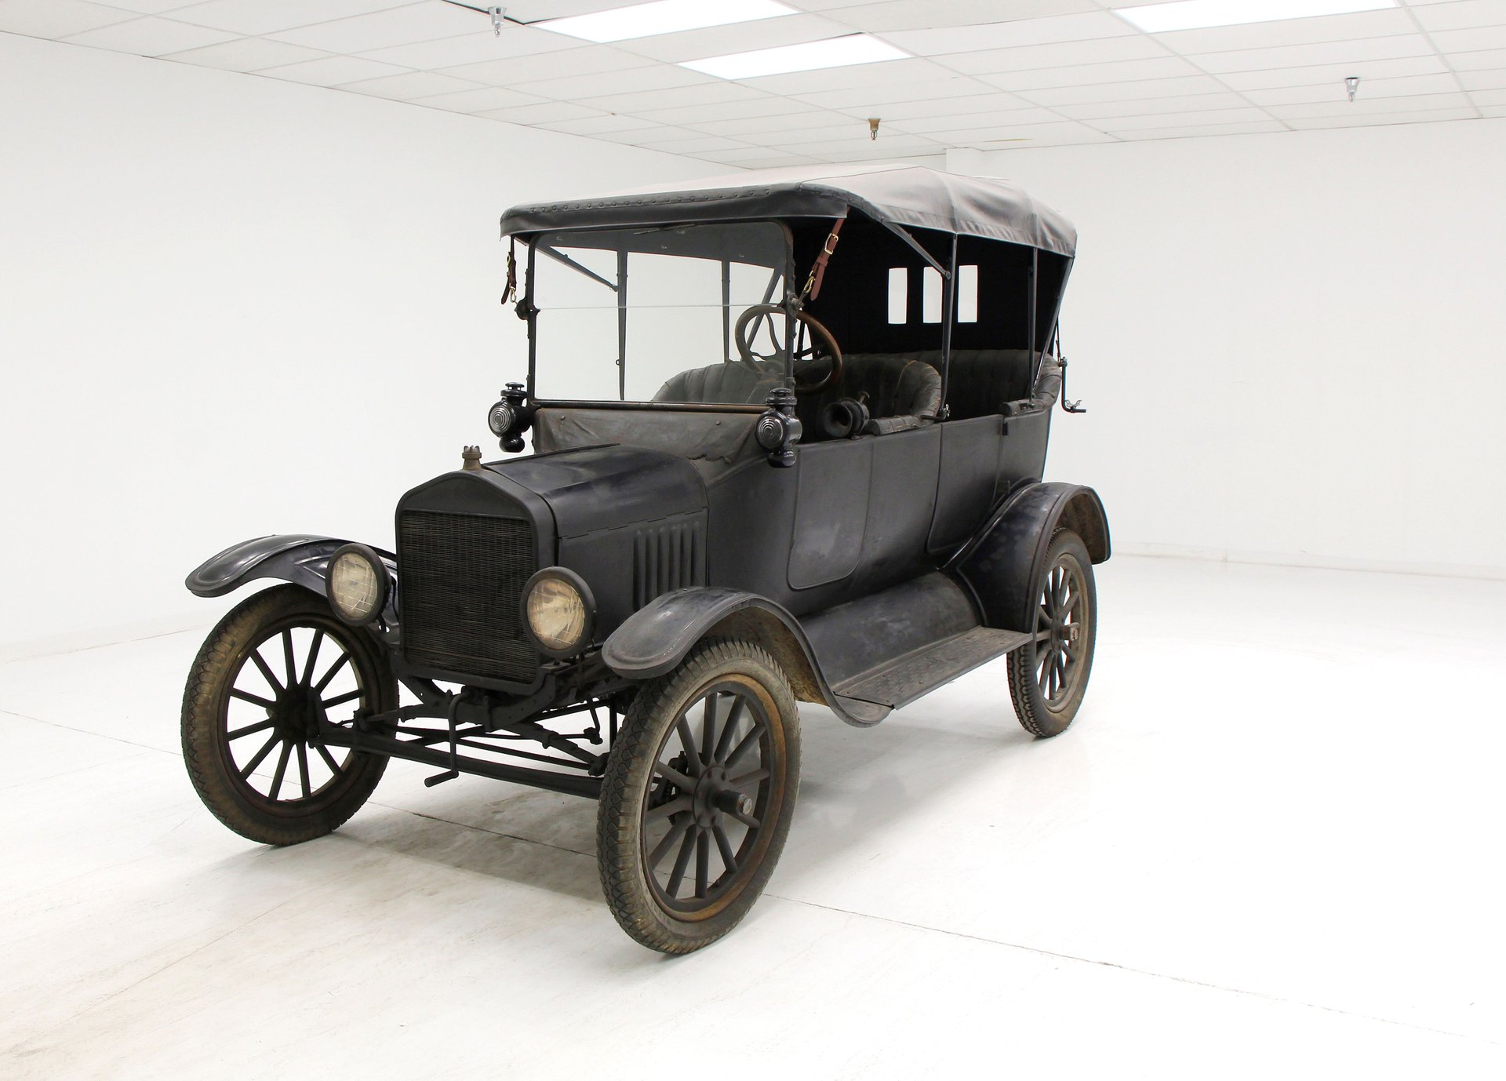
Why we need this?
ISO 26262: Road Vehicles - Functional Safety
One century ago, the Model T, which is considered the first mass-produced automobile, was powered by an electrical system
Today, the electrical and/or electronic (E/E) systems within automobiles are far more complex.
The IEC 61508 series of standards specifies any electronic safety-related system
To meet the specific needs of electrical and/or electronic systems within road vehicles, ISO 26262 was adapted from the IEC 61508 series.

Slide 4
About
ISO 26262: Road Vehicles - Functional Safety
Automotive Safety and Integrity Levels (ASIL)
ISO 26262 is an automotive functional safety standard for E/E systems defined by the International Organization for Standardization (ISO)
Least Critical
ASIL A
Infotainment system
Primary objective is to prevent accidents caused by system failures in vehicles
ASIL B
Adaptive Cruise Control
Provides a structured approach to managing the safety of electrical and electronic systems within automobiles for entire lifecycle
ASIL C
Anti-lock braking system
To classify components into ASILs, one must do the Hazard Analysis and Risk Assessment (HARA).
Most Critical
ASIL D
Airbag system

Slide 5

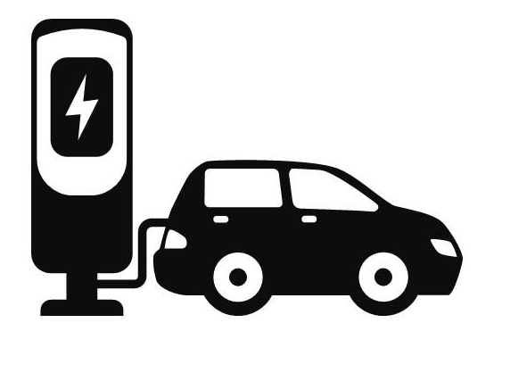


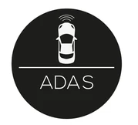


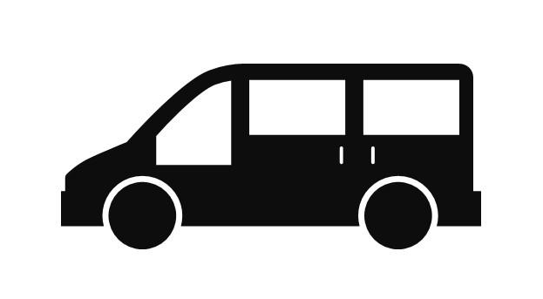
Application
ISO 26262: Road Vehicles - Functional Safety
ISO 26262 is applicable to a wide range of products and markets in the automotive industry.
It covers road vehicles, including passenger cars, commercial vehicles, and more.
It is relevant to various stakeholders in the automotive supply chain, including vehicle manufacturers, suppliers, and service providers.
Commercial Vehicle
Automotive software
Electric vehicles
Automotive supplier
Passenger Vehicle
Advanced driver assistance
Automotive products and repairs
Emerging technology

Slide 6
Main prescriptions
ISO 26262: Road Vehicles - Functional Safety
The parts or sections of ISO 26262 contribute to the prescriptions
Functional Safety management
Concept Phase
It requires the establishment of safety plans and the monitoring of safety goals throughout the development lifecycle. Project independent and project specific management activities in safety lifecycle
This is the concept phase, and it features item definition, hazard analysis and risk assessment, and the functional safety concept. Leads to determination of ASIL, safety goals and requirements for each safety-critical component.
Product development
Production and operations
Product development at system, software and hardware level. Includes safety specification, architectural design, verification, integration and testing
Safety considerations extend to the production and operational phases. Processes to maintain safety during these phases are defined.

Slide 7
Main prescriptions
ISO 26262: Road Vehicles - Functional Safety
Functional Safety assessment
Safety analysis and ASIL
Supporting processes for the functional safety such as verification, validation, and functional safety assessment to confirm that safety goals are achieved and that processes are followed correctly.
Safety-oriented analyses, such as Hazard Analysis and Risk Assessment (HARA), to determine the ASIL for each component.
Documentation and traceability
Guidelines
Comprehensive documentation is required to demonstrate compliance with the standard. This documentation must show traceability between safety goals, requirements, and verification activities.
The standard provides additional guidance on implementing ISO 26262 in the form of guidelines and recommendations.

Slide 8
Application to OuterSense
ISO 26262: Road Vehicles - Functional Safety
Automotive software
Emerging technology
Safety analysis and risk assessment
Perception : Ensuring robust external perception to have safe planning for vehicles. Latent perception can increase planning and control latency causing delayed response. Asses risk related to hardware and unit performance
Trajectory planning: Ensure correct plans are generated and wrong decisions are not made. Planner to handle latent sensor information and dynamic environments, generate plans feasible for follower to follow.
Control : Conduct sanity checks on planner and estimation output. Ensure vehicle follows plan accurately, stop the vehicle during emergencies.
System development and testing
Develop subsystem and conduct unit testing, ensure all safety goals and requirements are met
Conduct system level integrated testing for robustness and safety checks

Slide 9
#2. National Highway Traffic Safety Administration: Federal Automated Vehicles Policy
Notes:
The Federal Automated Vehicles Policy issued first by the U.S. National Highway Traffic Safety Administration in 2016. The policy is focused on Highly Automated Vehicles i.e. SAE L3, L4, L5; and it shapes the regulatory landscape for automated vehicles in the United States.

Slide 10
About
NHTSA Federal Automated Vehicles Policy
Shapes the regulatory landscape for automated vehicles in the United States
Policy focused on Highly Automated Vehicles (SAE L3, L4, L5)
Four sections
Vehicle Performance Guidance for Automated Vehicles
Model State Policy
NHTSA’s Current Regulatory Tools
New Tools and Authorities
Notes:
The intent for this policy was to serve as agency guidance to speed-up the delivery of an initial regulatory framework and best practices to guide manufacturers and other entities in the safe design, development, testing, and deployment of HAVs. It comprises of four sections: First: Vehicle Performance Guidance for Automated Vehicles which covers best practices to be followed prior to sale/deployment of the HAVs.
Secondly the Model State Policy which ensures the establishment of a consistent national framework rather than a patchwork of incompatible laws across states.
The third section was an overview of NHTSA’s current regulatory tools including how it applies to the introduction of new HAVs. Finally, the fourth section identifies potential new tools, authorities and regulatory structures for HAVs.

Slide 11
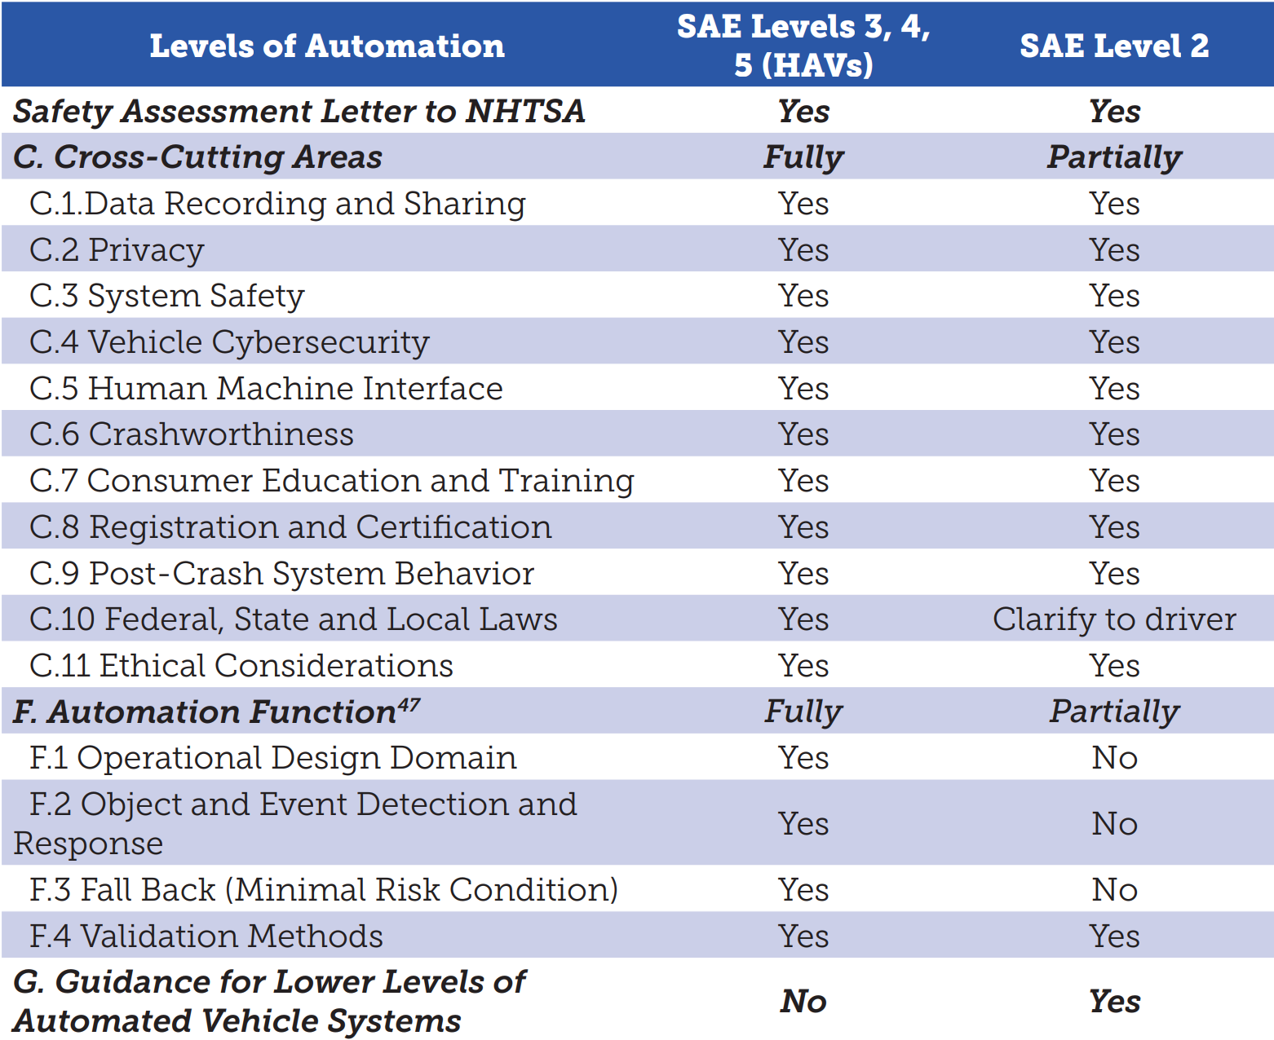
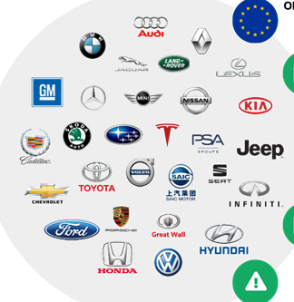

Application
NHTSA Federal Automated Vehicles Policy
Notes:
Applicable to all self-driving vehicles public roadways in the U.S. including consumer vehicles, robot-taxis, delivery vehicles etc.

Slide 12
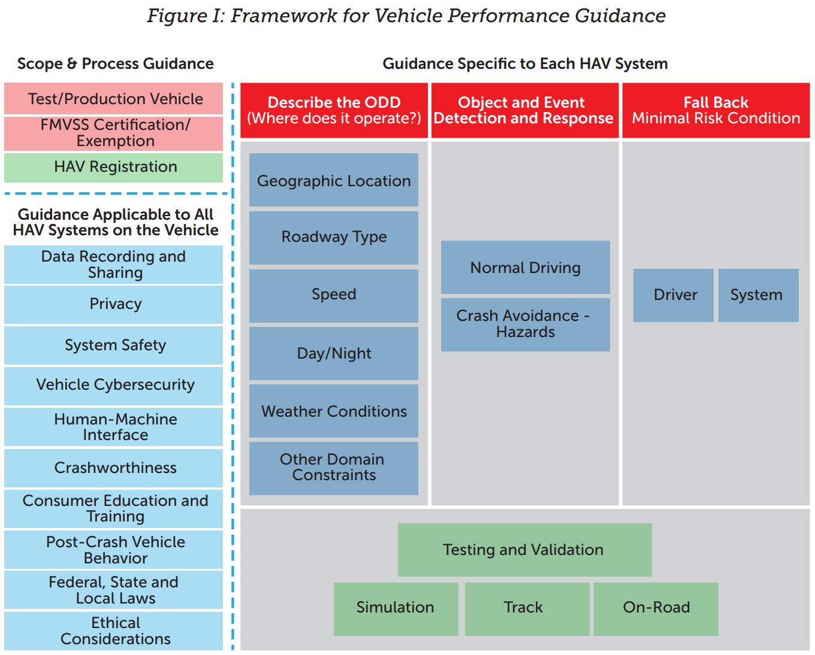
Main prescriptions
NHTSA Federal Automated Vehicles Policy
Vehicle Performance Guidance for Automated Vehicles
Notes:
Let’s dive deeper into the first section. The figure here captures DOT’s Vehicle Performance Guidance. The framework applies to both test and production vehicles, encompassing both new systems and updates.
For each automated system, it covers cross-cutting areas (shown on the left in light blue), and specifics to the function like defining the Operational Design Domain (ODD), Object and Event Detection and Response (OEDR), and minimum risk condition for fallback. To implement the framework, manufacturers must certify compliance with relevant Federal Motor Vehicle Safety Standard standards or seek NHTSA interpretations or exemptions as necessary.

Slide 13
Main prescriptions
Vehicle Performance Guidance for Automated Vehicles Section F: Specifics for Automation Functions
NHTSA Federal Automated Vehicles Policy
Operational Design Domain | 2. Object and Event Detection and Response
• Roadway types • Geographic area • Speed range • Environmental conditions • Other domain constraints | • Other vehicles (in and out of its travel path) • Pedestrians,cyclists, animals, other objects • Emergency vehicles • Temporary work zones • Other unusual conditions
Notes:
Let’s go over the specific guidance for automation functions. The Operational Design Domain document is required for each HAV system and must describe the specific operating domain(s) in which the HAV system is designed to properly operate.
When functioning in the ODD, the Object and Event Detection and Response (OEDR) refers to the detection by the driver or HAV system of any circumstance that is relevant to the immediate driving task, as well as the implementation of the appropriate driver or HAV system response to such circumstance.
HAVs are expected to be able to detect and respond to other vehicles (in and out of its travel path), pedestrians, cyclists, animals, emergency vehicles, temporary work zones, and other unusual conditions (e.g., police manually directing traffic, construction worker controlling traffic).
Adherence to this regulation requires documented process for assessment, testing, and validation of their OEDR capabilities.

Slide 14
Main prescriptions
Vehicle Performance Guidance for Automated Vehicles Section F: Specifics for Automation Functions
NHTSA Federal Automated Vehicles Policy
3. Fall Back (Minimal Risk Condition) | 4. Validation Methods
• Capability to detect malfunctions, degraded state, or operation outside of ODD • Fall back actions should facilitate safe operations of the vehicle and minimize erratic driving behavior | • Tests to demonstrate the performance during normal operation, crash avoidance situations, and fall back strategies. • Combination of simulation, test track, and on-road testing
Notes:
A documented process for transitioning to a minimal risk condition when a problem is encountered is required. This requires the capability to detect malfunctions, degraded performance of the the system, or operation outside of ODD. Post detection the system must execute a fallback action that is safe and does not assume the attention/presence of a human driver (depending on the level of automation). Finally, the system’s performance during each of the behaviours - normal operations, crash avoidance situations, and fall back strategies must be supported with a documented process for assessment, testing, and validation of the capabilities. This must be done using a combination of multiple environments i.e. simulations, test tracks and on-road.

Slide 15
Application to OuterSense
NHTSA Federal Automated Vehicles Policy
Operational Design Domain for OuterSense
Environment spanned by overhead cameras with overlapping FOVs
Pre-defined map with known road dimensions and traffic signs
Well illuminated environment
Driving speed - up to 15 miles per hour (PR4, DPR2)
Access to a reliable wireless communication network in the environment

Slide 16
Application to OuterSense
NHTSA Federal Automated Vehicles Policy
Object and Event Detection
The OuterSense perception system can detect obstacles/other vehicles/actors with 95% success rate
Response
No collisions with other controlled vehicles (PR1)
No collisions with static and dynamic obstacles (DPR3)

Slide 17
Application to OuterSense
NHTSA Federal Automated Vehicles Policy
Fall Back (Minimal Risk Condition)
Identification | Action
Operation outside ODD Detect if a vehicle is outside the FOV of the infrastructure sensor Commanded speeds higher than 15 mph Degraded performance Detect latency in receiving new control actions from the cloud | 1.1 Follow the safety profile to a smooth stop if no detection in found on 0.5s 1.2 Clip to 15mph at all levels 2.1 Follow the time-synchronized motion cues - follow the safety profile to come to a smooth stop if no new motion cues are received.

Slide 18
Application to OuterSense
NHTSA Federal Automated Vehicles Policy
Validation
Simulation
Use recorded data from manual drives to validate autonomy functions (perception, state estimation, planning)
Test-track
Integrated system can safely control vehicles in the ODD adhering to the requirements
(Tests 1-12 outlined in the Fall Test Plan)

Slide 19
Thank You

